Slide 1
CSE 2133 - Business Programming with File Processing
The OpenCOBOL Development Environment

Slide 2
OpenCOBOL 1.1
http://www.opencobol.org/
Open-source COBOL compiler
Implements a substantial part of the COBOL 85 and COBOL 2002 standards
Translates COBOL into C and compiles the translated code using a native C compiler
Various platforms: Unix/Linux, Mac OS X, and Microsoft Windows
The compiler is licensed under GNU General Public License
The run-time library is licensed under GNU Lesser General Public License

Slide 3
GNU General Public License
Free, copyleft license for software and other kinds of works
Free software refers to freedom, not price
Freedom to distribute copies of free software (and charge for them if you wish)
Receive source code or can get it if wanted
Change the software or use pieces of it in new free programs
If distribute copies of the software, or modify it; must respect these freedom of others

Slide 4
Installing OpenCOBOL
Install Guides found on course Carmen page
Windows: InstallOpenCobolWin.pdf
Mac: InstallOpenCobolMac.pdf
Software install packages also on Carmen page
Windows: OpenCOBOL_Win.zip
Mac: OpenCOBOL_Mac.zip

Slide 5
Writing COBOL Code
Source code files are plain text
Use text editors to write/edit source code
Notepad
NotePad++
SublimeText
Use the extension “.cob” for the labs
No word processors
Files contain embedded formatting and control characters

Slide 6
High and Low-Level Languages
Computers only understand machine language
Binary language made up of 0s and 1s
Hardware-dependant
This is a low-level language
People cannot write/read machine language easily
Need high-level languages, such as COBOL and Java

Slide 7
Compilers
Compilers are programs that translate the high-level code into machine language
High-level: Now.cob (source code)
Low-level: Now.exe (binary)
Compilers also perform syntax-checks on the high-level code
Ensures code follows rules of the language
If not, receive syntax/compile errors
Only creates a new binary file if all syntax is valid

Slide 8
Compiling COBOL Code
Compiling is done from the command line (for those using Windows)
Command to compile is cobc –x pgm.cob
-x directs compiler to create an executable file
Command is executed from the folder containing the .cob file
Successful compile results in a new .exe file
Same name as the .cob file

Slide 9
Compiling COBOL Code
Note the following sequence
Successful compile of lab1.cob
Folder now contains the file lab1.exe
Make changes to lab1.cob
Compiling lab1.cob is now unsuccessful
Folder still contains the previous lab1.exe. Do not let the existence of this file imply the last compile was a success. If the compile has error messages, then it was not successful

Slide 10
Getting to the Command Line
In Windows Explorer, holding down the Shift key while right-clicking a folder in the left pane will put “Open Command Window Here” as an option in the context menu
Will likely want to open the command window on the folder containing your COBOL source code file

Slide 11
Getting to the Command Line
Or, from the Start Menu, entering “cmd” in the “Search programs and files” box will open the command window
No control over where it opens
Will open in your Users folder

Slide 12
Navigating the Command Line
To switch drives, enter the drive letter followed by the colon
D: changes to the D drive
To change folders, use the cd (change directory) command
cd lab4 changes to folder named lab4 that is a subfolder of the current folder
cd \cobol changes to a folder named cobol that is a subfolder of the root

Slide 13
Navigating the Command Line
Can use the up and down arrows to cycle through previous commands
Can use the tab key to complete folder and file names
Two dots (..) is short-hand for the parent folder

Slide 14
Command Line Commands
dir Lists files in the current folder
mkdir Creates a new folder
Easier to do within Windows Explorer

Slide 15
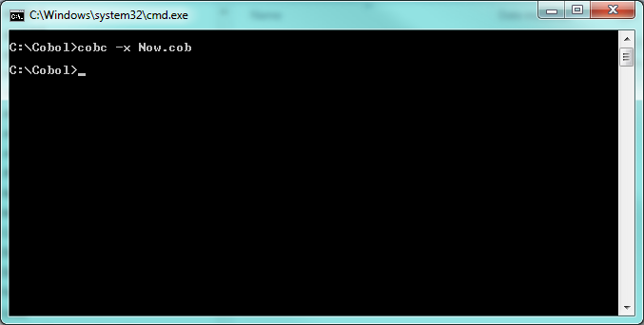
Compiling COBOL Code
No Syntax Errors:

Slide 16
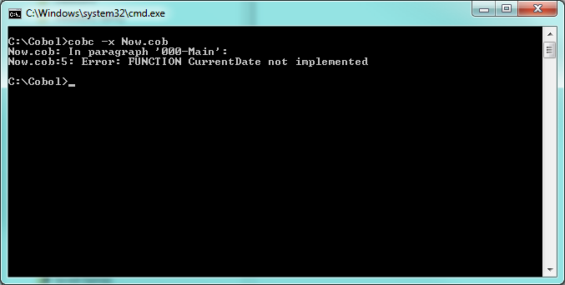
Compiling COBOL Code
Syntax Error:

Slide 17
Executing COBOL Program
Also from the command line
Command is the name of the .exe file
.exe is not required
Types of errors during execution
Run-Time Error/Exception: When the program throws an error during execution
Logic Error: Program executes cleanly, but output is incorrect

Slide 18
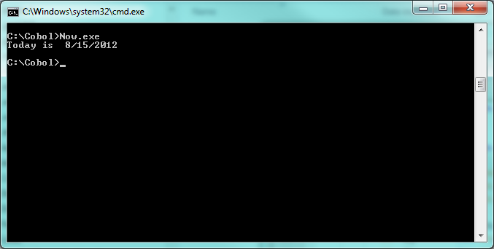
Executing COBOL Code
Clean Execution:

Slide 19
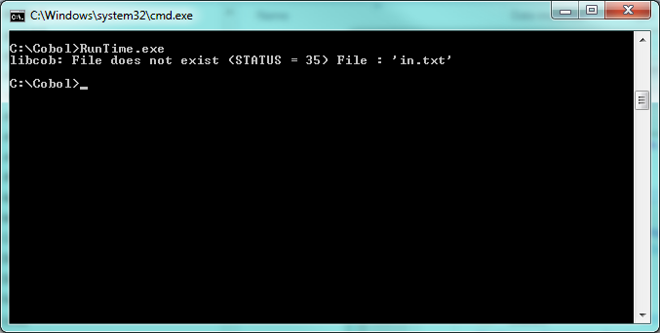
Executing COBOL Code
Run-Time Error:

Slide 20
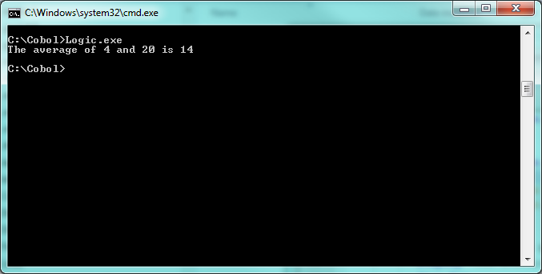
Executing COBOL Code
Logic Error:

Slide 21
Programming Assignments
Assignments will be posted on Carmen
All file names are specified in assignment
Files to submit to the grader are specified in assignment
Submitted to grader via email
All files are to be packaged into a single zip file
Email at some point on the due day
Timestamp on email is submission date/time
Late submissions penalized 10% per day

Slide 22
Programming Assignments
Test files will be provided for assignments that require file input
These test files may not cover all situations
Feel free to add/change records
Grader will use different files for actual grading of assignments
These files will have the same name and format (record layouts) as the test files
Do not program for a specific set of data values

Slide 23
Programming Assignments
“No input” is a valid scenario
File exists but has no records (empty file)
Interactive program where the user immediately terminates execution
Programs must be able to handle these situations gracefully (not crash)

Slide 24
Programming Assignments
The following situations are catastrophic, and will receive a grade of 0
Programs that do not cleanly compile
There cannot be any error or warning messages
Programs that crash or throw exceptions (errors) during execution
There cannot be any error or warning messages
Programs that produce garbage output
Programs that do not end on their own
If this happens, Ctrl+C will stop program execution

Slide 25
Programming Assignments
Coding standards for this class can be found on the course’s Carmen page in a document titled “CodingStandards.pdf”
These will be checked when your assignments are graded

Slide 26
“The last good thing written in C was Franz Schubert's Symphony No. 9.” -- Werner Trobin

